Slide 1


The PiXL Club The PiXL Club The PiXL Club The PiXL Club The PiXL Club The PiXL Club The PiXL Club The PiXL Club The PiXL Club The PiXL Club The PiXL Club The PiXL Club The PiXL Club The PiXL Club The PiXL Club The PiXL Club The PiXL Club The PiXL Club The PiXL Club The PiXL Club The PiXL Club The PiXL Club The PiXL Club The PiXL Club The PiXL Club The PiXL Club The PiXL Club The PiXL Club The PiXL Club The PiXL Club The PiXL Club The PiXL Club The PiXL Club The PiXL Club The PiXL Club The PiXL Club The PiXL Club The PiXL Club The PiXL Club The PiXL Club The PiXL Club The PiXL Club The PiXL Club The PiXL Club The PiXL Club XL Club The PiXL Club The PiXL Club The PiXL Club The PiXL Club The PiXL Club The PiXL Club The PiXL Club The PiXL Club The PiXL Club The PiXL Club The PiXL Club The PiXL Club The PiXL Club The PiXL Club The PiXL Club The PiXL Club The PiXL Club The PiXL Club The PiXL Club The PiXL Club The PiXL Club The PiXL Club The PiXL Club The PiXL Club The PiXL Club The PiXL Club The PiXL Club The PiXL Club The PiXL Club The PiXL Club The PiXL Club The PiXL Club The PiXL Club The PiXL Club The PiXL Club The PiXL Club The PiXL Club The PiXL Club The PiXL Club The PiXL Club The PiXL Club The PiXL Club The PiXL Club The PiXL Club The PiXL Club The PiXL Club The PiXL Club The PiXL Club The PiXL Club The PiXL Club The PiXL Club The PiXL Club The PiXL Club The PiXL Club The PiXL Club The PiXL Club The PiXL Club The PiXL Club The PiXL Club The PiXL Club The PiXL Club The PiXL Club The PiXL Club The PiXL Club The PiXL Club The PiXL Club The PiXL Club The PiXL Club The PiXL Club The PiXL Club The PiXL Club The PiXL Club The PiXL Club The PiXL Club The PiXL Club The PiXL Club The PiXL Club The PiXL Club The PiXL Club The PiXL Club The PiXL Club The PiXL Club The PiXL Club The PiXL Club The PiXL Club The PiXL Club The PiXL Club The PiXL Club The PiXL Club The PiXL Club The PiXL Club The PiXL Club The PiXL Club The PiXL Club The PiXL Club The PiXL Club The PiXL Club The PiXL Club The PiXL Club The PiXL Club The PiXL Club The PiXL Club The PiXL Club The PiXL Club The PiXL Club The PiXL Club The PiXL Club The PiXL Club The PiXL Club The PiXL Club The PiXL Club The PiXL Club The PiXL Club The PiXL Club The PiXL Club The PiXL Club The PiXL Club The PiXL Club The PiXL Club The PiXL Club The PiXL Club The PiXL Club The PiXL Club The PiXL Club The PiXL Club The PiXL Club The PiXL Club The PiXL Club The PiXL Club The PiXL Club The PiXL Club The PiXL Club The PiXL Club The PiXL Club The PiXL Club The PiXL Club The PiXL Club The PiXL Club The PiXL Club The PiXL Club The PiXL Club The PiXL Club The PiXL Club The PiXL Club The PiXL Club The PiXL Club The PiXL Club The PiXL Club The PiXL Club The PiXL Club The PiXL Club The PiXL Club The PiXL Club The PiXL Club The PiXL Club The PiXL Club The PiXL Club The PiXL Club The PiXL Club The PiXL Club The PiXL Club The PiXL Club The PiXL Club The PiXL Club The PiXL Club The PiXL Club The PiXL Club The PiXL Club The PiXL Club The PiXL Club The PiXL Club The PiXL Club The PiXL Club The PiXL Club The PiXL Club The PiXL Club The PiXL Club The PiXL Club The PiXL Club The PiXL Club The PiXL Club The PiXL Club The PiXL Club The PiXL Club The PiXL Club The PiXL Club The PiXL Club The PiXL Club The PiXL Club The PiXL Club The PiXL Club The PiXL Club The PiXL Club The PiXL Club The PiXL Club The PiXL Club The PiXL Club The PiXL Club The PiXL Club The PiXL Club The PiXL Club The PiXL Club The PiXL Club The PiXL Club The PiXL Club The PiXL Club The PiXL Club The PiXL Club The PiXL Club The PiXL Club The PiXL Club The PiXL Club The PiXL Club The PiXL Club The PiXL Club The PiXL Club The PiXL Club The PiXL Club The PiXL Club The PiXL Club The PiXL Club The PiXL Club The PiXL Club The PiXL Club The PiXL Club The PiXL Club The PiXL Club The PiXL Club The PiXL Club The PiXL Club The PiXL Club The PiXL Club The PiXL Club The PiXL Club The PiXL Club The PiXL Club The PiXL Club The PiXL Club The PiXL Club The PiXL Club The PiXL Club The PiXL Club The PiXL Club The PiXL Club The PiXL Club The PiXL Club The PiXL Club The PiXL Club The PiXL Club The PiXL Club The PiXL Club The PiXL Club The PiXL Club The PiXL Club The PiXL Club The PiXL Club The PiXL Club The PiXL Club The PiXL Club The PiXL Club The PiXL Club The PiXL Club The PiXL Club The PiXL Club The PiXL Club The PiXL Club The PiXL Club The PiXL Club The PiXL Club The PiXL Club The PiXL Club The PiXL Club The PiXL Club The PiXL Club The PiXL Club The PiXL Club The PiXL Club The PiXL Club The PiXL Club The PiXL Club The PiXL Club The PiXL Club The PiXL Club The PiXL Club The PiXL Club The PiXL Club The PiXL Club The PiXL Club The PiXL Club The PiXL Club The PiXL Club The PiXL Club The PiXL Club The PiXL Club The PiXL Club The PiXL Club The PiXL Club The PiXL Club The PiXL Club The PiXL Club The PiXL Club The PiXL Club The PiXL Club The PiXL Club The PiXL Club The PiXL Club The PiXL Club The PiXL Club The PiXL Club The PiXL Club The PiXL Club The PiXL Club The PiXL Club The PiXL Club The PiXL Club The PiXL Club The PiXL Club The PiXL Club The PiXL Club The PiXL Club The PiXL Club The PiXL Club The PiXL Club The PiXL Club The PiXL Club The PiXL Club The PiXL Club The PiXL Club The PiXL Club The PiXL Club The PiXL Club The PiXL Club The PiXL Club The PiXL Club The PiXL Club The PiXL Club The PiXL Club The PiXL Club The PiXL Club The PiXL Club The PiXL Club The PiXL Club The PiXL Club The PiXL Club The PiXL Club The PiXL Club The PiXL Club The PiXL Club The PiXL Club The PiXL Club The PiXL Club The PiXL Club The PiXL Club The PiXL Club The PiXL Club The PiXL Club The PiXL Club The PiXL Club The PiXL Club The PiXL Club The PiXL Club The PiXL Club The PiXL Club The PiXL Club The PiXL Club The PiXL Club The PiXL Club The PiXL Club The PiXL Club The PiXL Club The PiXL Club The PiXL Club The PiXL Club The PiXL Club The PiXL Club The PiXL Club The PiXL Club The PiXL Club The PiXL Club The PiXL Club The PiXL Club The PiXL Club The PiXL Club The PiXL Club The PiXL Club The PiXL Club The PiXL Club The PiXL Club The PiXL Club The PiXL Club The PiXL Club The PiXL Club The PiXL Club The PiXL Club The PiXL Club The PiXL Club The PiXL Club The PiXL Club The PiXL Club The PiXL Club The PiXL Club The PiXL Club The PiXL Club The PiXL Club The PiXL Club The PiXL Club The PiXL Club The PiXL Club The PiXL Club The PiXL Club The PiXL Club The PiXL Club The PiXL Club The PiXL Club The PiXL Club The PiXL Club The PiXL Club The PiXL Club The PiXL Club The PiXL Club The PiXL Club The PiXL Club The PiXL Club The PiXL Club The PiXL Club The PiXL Club The PiXL Club The PiXL Club The PiXL Club The PiXL Club The PiXL Club The PiXL Club The PiXL Club The PiXL Club The PiXL Club The PiXL Club The PiXL Club The PiXL Club The PiXL Club The PiXL Club The PiXL Club The PiXL Club The PiXL Club The PiXL Club The PiXL Club The PiXL Club The PiXL Club The PiXL Club The PiXL Club The PiXL Club The PiXL Club The PiXL Club The PiXL Club The PiXL Club The PiXL Club The PiXL Club The PiXL Club The PiXL Club The PiXL Club The PiXL Club The PiXL Club The PiXL Club The PiXL Club The PiXL Club The PiXL Club The PiXL Club The PiXL Club The PiXL Club The PiXL Club The PiXL Club The PiXL Club The PiXL Club The PiXL Club The PiXL Club The PiXL Club The PiXL Club The PiXL Club The PiXL Club The PiXL Club The PiXL Club The PiXL Club The PiXL Club The PiXL Club The PiXL Club The PiXL Club The PiXL Club The PiXL Club The PiXL Club The PiXL Club The PiXL Club The PiXL Club The PiXL Club The PiXL Club The PiXL Club The PiXL Club The PiXL Club The PiXL Club The PiXL Club The PiXL Club The PiXL Club The PiXL Club The PiXL Club The PiXL Club The PiXL Club The PiXL Club The PiXL Club The PiXL Club The PiXL Club The PiXL Club The PiXL Club The PiXL Club The PiXL Club The PiXL Club The PiXL Club The PiXL Club The PiXL Club The PiXL Club The PiXL Club The PiXL Club The PiXL Club The PiXL Club The PiXL Club The PiXL Club The PiXL Club The PiXL Club The PiXL Club The PiXL Club The PiXL Club The PiXL Club The PiXL Club The PiXL Club The PiXL Club The PiXL Club The PiXL Club The PiXL Club The PiXL Club The PiXL Club The PiXL Club The PiXL Club The PiXL Club The PiXL Club The PiXL Club The PiXL Club The PiXL Club The PiXL Club The PiXL Club The PiXL Club The PiXL Club The PiXL Club The PiXL Club The PiXL Club The PiXL Club The PiXL Club The PiXL Club The PiXL Club The PiXL Club The PiXL Club The PiXL Club The PiXL Club The PiXL Club The PiXL Club The PiXL Club The PiXL Club The PiXL Club The PiXL Club The PiXL Club The PiXL Club The PiXL Club The PiXL Club The PiXL Club The PiXL Club The PiXL Club The PiXL Club The PiXL Club The PiXL Club The PiXL Club The PiXL Club The PiXL Club The PiXL Club The PiXL Club The PiXL Club The PiXL Club The PiXL Club The PiXL Club The PiXL Club The PiXL Club The PiXL Club The PiXL Club The PiXL Club The PiXL Club The PiXL Club The PiXL Club The PiXL Club The PiXL Club The PiXL Club The PiXL Club The PiXL Club The PiXL Club The PiXL Club The PiXL Club The PiXL Club The PiXL Club The PiXL Club The PiXL Club The PiXL Club The PiXL Club The PiXL Club The PiXL Club The PiXL Club The PiXL Club The PiXL Club The PiXL Club The PiXL Club The PiXL Club The PiXL Club The PiXL Club The PiXL Club The PiXL Club The PiXL Club The PiXL Club The PiXL Club The PiXL Club The PiXL Club The PiXL Club The PiXL Club The PiXL Club The PiXL Club The PiXL Club The PiXL Club The PiXL Club The PiXL Club The PiXL Club The PiXL Club The PiXL Club The PiXL Club The PiXL Club The PiXL Club The PiXL Club The PiXL Club The PiXL Club The PiXL Club The PiXL Club The PiXL Club The PiXL Club The PiXL Club The PiXL Club The PiXL Club The PiXL Club The PiXL Club The PiXL Club The PiXL Club The PiXL Club The PiXL Club The PiXL Club The PiXL Club The PiXL Club The PiXL Club The PiXL Club The PiXL Club The PiXL Club The PiXL Club The PiXL Club The PiXL Club The PiXL Club The PiXL Club The PiXL Club The PiXL Club The PiXL Club The PiXL Club The PiXL Club The PiXL Club The PiXL Club The PiXL Club The PiXL Club The PiXL Club The PiXL Club The PiXL Club The PiXL Club The PiXL Club The PiXL Club The PiXL Club The PiXL Club The PiXL Club The PiXL Club The PiXL Club The PiXL Club The PiXL Club The PiXL Club The PiXL Club The PiXL Club The PiXL Club The PiXL Club The PiXL Club The PiXL Club The PiXL Club The PiXL Club The PiXL Club The PiXL Club The PiXL Club The PiXL Club
PiXL KnowIT!
GCSE Chemistry
AQA Topic – Bonding, structure and the properties of matter
© Copyright The PiXL Club Ltd, 2017
This resource is strictly for the use of member schools for as long as they remain members of The PiXL Club. It may not be copied, sold nor transferred to a third party or used by the school after membership ceases. Until such time it may be freely used within the member school.
All opinions and contributions are those of the authors. The contents of this resource are not connected with nor endorsed by any other company, organisation or institution.
www.pixl.org.uk The PiXL Club Ltd, Company number 07321607

Slide 2
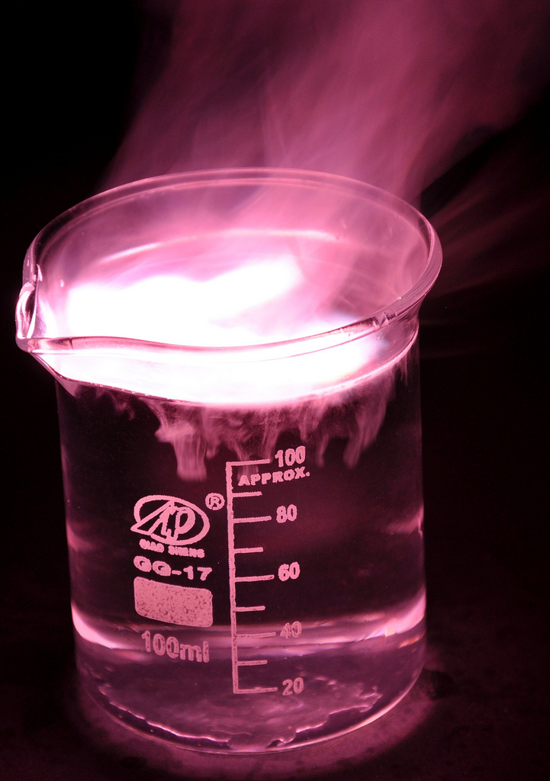
Overview
Bonding, Structure and the properties of matter
Bonding
  Chemical bonds
  Ionic bonding
  Ionic compounds
  Covalent bonding
  Metallic bonding
Properties of substances
  States of matter
  State symbols
  Properties of ionic compounds
  Properties of small molecules
  Polymers
  Giant covalent structures
  Properties of metals and alloys
Structure and bonding of carbon
  Diamond, graphite
  Graphene and fullerenes
Nanoparticles (Chemistry ONLY)
  Size of particles
  Uses of nanoparticles
Notes:
https://c2.staticflickr.com/4/3178/4076380768_03994aed44_b.jpg

Slide 3

LearnIT!
KnowIT!
Bonding part 1
Chemical bonds
Ionic bonding
Ionic compounds

Slide 4
  Chemical bonds
There are three types of strong chemical bonds:
                Ionic
                Covalent
                Metallic
Ionic | Covalent | Metallic
Particles are oppositely charged ions | Particles are atoms which share pairs of electrons | Particles are atoms which share delocalised electrons
Between metals and non-metals | Most non-metallic elements Between non-metals and non-metals | In metallic elements and alloys
You need to be able to explain chemical bonding in terms of electrostatic forces and the transfer of electrons.

Slide 5
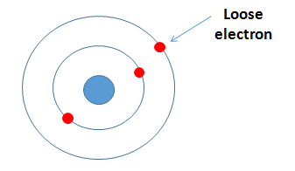
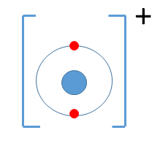
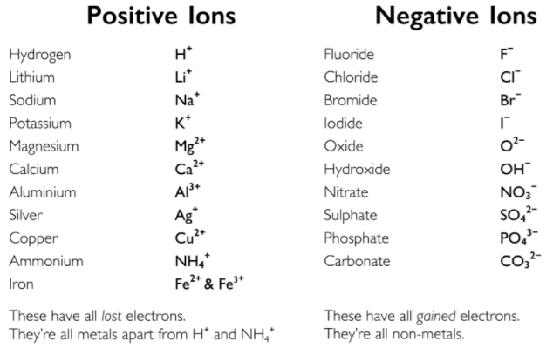
  Ionic bonding
Ionic bonds form between metals and non-metals. Ionic bonding involves the transfer of electrons in the outer shells.
Metals lose electrons to become positively charged ions
and non-metals gain electrons to become negatively
charged ions.
The elements in Group 1 react with the elements in Group 7.
Groups 1 elements can each lose one electron.
This electron can be given to an atom from Group 7, they both achieve the stable electronic structure of a noble gas.
Notes:
https://examhints.files.wordpress.com/2014/10/ions-list.png

Slide 6
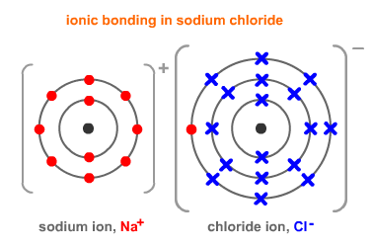
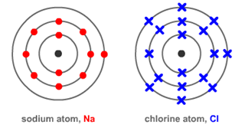
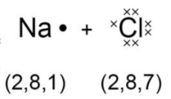
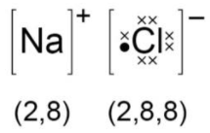
  Ionic bonding
The electrostatic attraction between the oppositely charged Na⁺ ions and Cl⁻ ions is called ionic bonding. The electron transfer during the formation of an ionic compound can be represented by a dot and cross diagram:
The charge on the ions produced by metals in group 1 and 2 and by non-metals in group 6 and 7 relates to the group number of the element in the periodic table. For example group 1 form 1+ ions, group 3 form 3+ ions, group 6 form 2- ions and group 7 form 1- ions.
When completing diagrams always include:
The correct number of electrons on outer shells
The charge

Slide 7
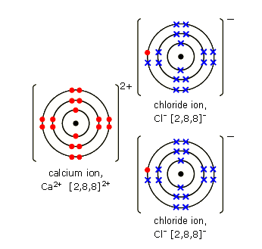
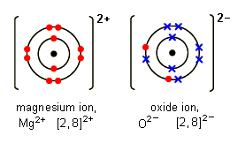
  Ionic bonding
Magnesium oxide:
Sometimes the atoms reacting need to gain or lose two electrons to gain a stable noble gas structure. Each magnesium loses two electrons and each oxygen gains two electrons.
Magnesium ions have the formula Mg²⁺, while oxide ions have the formula O²⁻ .
This means that one magnesium atom reacts with one oxygen atom, giving the formula MgO
Calcium Chloride:
Each calcium atom (2, 8, 8, 2) needs to lose two electrons but each chlorine atom (2, 8, 7) needs to gain only one electron.
This means that two chlorine atoms
react with every one calcium atom, giving the formula CaCl₂
Notes:
https://www.google.co.uk/url?sa=i&rct=j&q=&esrc=s&source=images&cd=&cad=rja&uact=8&ved=0ahUKEwj83_7Kp7nVAhViDMAKHUa-BjEQjRwIBw&url=http%3A%2F%2Fwww.bbc.co.uk%2Feducation%2Fguides%2Fzccmn39%2Frevision&psig=AFQjCNEgBoTtwHYRcEQ-aOWdYS2_agBv1g&ust=1501789374706607

Slide 8
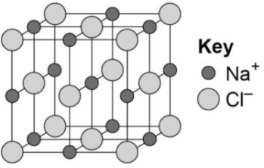
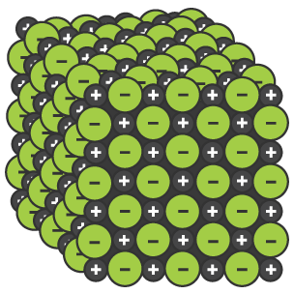
  Ionic compounds
An ionic compound is a giant structure of ions.
Ionic compounds are held together by strong electrostatic forces of attraction between oppositely charges ions. These forces act in all directions in the lattice – this is called ionic bonding.
Empirical formula
The models can indicate the chemical formula of a compound by the simplest ratio of atoms or ions in models of their giant structure – this is called the empirical formula.
e.g. there is a 1:1 ratio of sodium to chlorine in sodium chloride, so the formula is NaCl.
The structure of sodium chloride can be represented in the following forms:
- The models never accurately reflect the many millions of atoms/ions bonded together in the giant lattices

Slide 9

QuestionIT!
Bonding part 1
Chemical bonds
Ionic bonding
Ionic compounds

Slide 10
  Bonding PART 1 – QuestionIT
What are the three types of strong chemical bond?
What particles are found in:
  Ionic bonding
  Covalent bonding
  Metallic bonding?
Which type of bonds occurs when metals combine with non-metals?
What type of bonding occurs in carbon dioxide? Why?
What type of bonding occurs in alloys?

Slide 11
  Bonding PART 1 – QuestionIT
What happens to the electrons in ionic bonding?
What electronic structure do the ions produced by metals in Groups 1 and 2 and the non-metals in Groups 6 and 7 have?
What is the link between the charge number on the ions in groups 1, 2 and 3 and their group number ?
What is an ionic compound?
How are ionic compounds held together?

Slide 12
  Bonding PART 1 – QuestionIT
Why is the ball and stick model not an accurate representation of the structure of an ionic compound?
Draw a diagram to show how potassium and chlorine atoms
join together to form ions.
Explain how you can use the following model to work out the empirical formula of sodium chloride.

Slide 13

AnswerIT!
Bonding part 1
Chemical bonds
Ionic bonding
Ionic compounds

Slide 14
  Bonding PART 1 – QuestionIT
What are the three types of strong chemical bond?
  Ionic, covalent, metallic.
What particles are found in:
  Ionic bonding oppositely charged ions.
  Covalent bonding atoms which share electrons.
  Metallic bonding? Atoms which share delocalised electrons.
Which type of bonds occurs when metals combine with non-metals?
  Ionic.
What type of bonding occurs in carbon dioxide? Why?
  Covalent; two non-metals.
What type of bonding occurs in alloys?
  Metallic.

Slide 15
  Bonding PART 1 – QuestionIT
What happens to the electrons in ionic bonding?
  Transferred.
What electronic structure do the ions produced by metals in Groups 1 and 2 and the non-metals in Groups 6 and 7 have?
  Electronic structure of a noble gas.
What is the link between the charge number on the ions in groups 1, 2 and 3 and their group number ?
  Charge number is same as Group number.
What is an ionic compound?
  Giant structure of ions.
How are ionic compounds held together?
  Strong electrostatic forces of attraction; between oppositely charged ions.

Slide 16
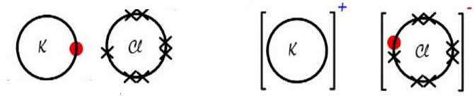
  Bonding PART 1 – QuestionIT
Why is the ball and stick model not an accurate representation of the structure of an ionic compound?
  Does not accurately depict the millions of ions in the lattice. The ions should touch each other/ there are no gaps between the ions.
Draw a diagram to show how potassium and chlorine atoms
join together to form ions.

Slide 17
  Ionic bonding PART 2 – QuestionIT
Explain how you can use the following model of sodium chloride to work out the empirical formula.
Count the number of each type of atom in the giant structure and work out simplest whole number ratio.

Slide 18
LearnIT!
KnowIT!
Bonding
PART 2
  Covalent bonding
  Metallic bonding

Slide 19
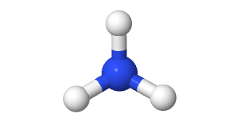
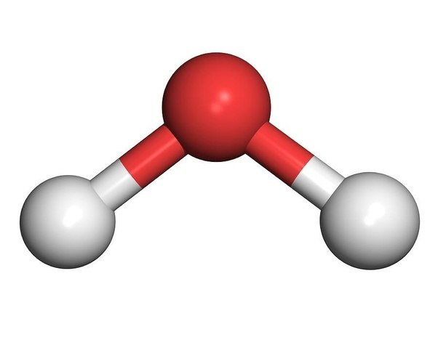
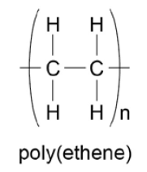
  Covalent bonding - PART 1
When atoms share pairs of electrons, they form covalent bonds.
These are STRONG bonds.
Covalently bonded substances may be: Small molecules, very large molecules or giant covalent structures.
NH₃
H
H₂O
You can deduce the molecular formula of a substance from a given model or diagram showing the atoms and bonds in the molecule by counting the number of atoms.
O
N
H
H
H
H
Polymers are examples of very large covalent molecules, they can be represented in the form: where ‘n’ = a very large number!
Examples of covalently bonded substances with giant covalent structures are diamond and silicon dioxide.
Notes:
https://www.google.co.uk/url?sa=i&rct=j&q=&esrc=s&source=images&cd=&cad=rja&uact=8&ved=0ahUKEwiPu_Gf4bjVAhWpqVQKHT5nDzwQjRwIBw&url=http%3A%2F%2Fwww.historyoftheuniverse.com%2Findex.php%3Fp%3Dnitrogen.htm&psig=AFQjCNHbB72WgjFaiV6T9gpkLrR0o42JUQ&ust=1501770468520684
https://www.google.co.uk/url?sa=i&rct=j&q=&esrc=s&source=images&cd=&cad=rja&uact=8&ved=0ahUKEwjR96uG97jVAhXHK8AKHTJtCvkQjRwIBw&url=https%3A%2F%2Fwww.quora.com%2FBoth-H2O-and-CO2-are-covalently-bonded-particles-Which-experiences-stronger-forces-of-attraction-between-its-particles-H2O-or-CO2&psig=AFQjCNHgR7lQOEvAsLNkknh2W390tWdutQ&ust=1501776343501473

Slide 20
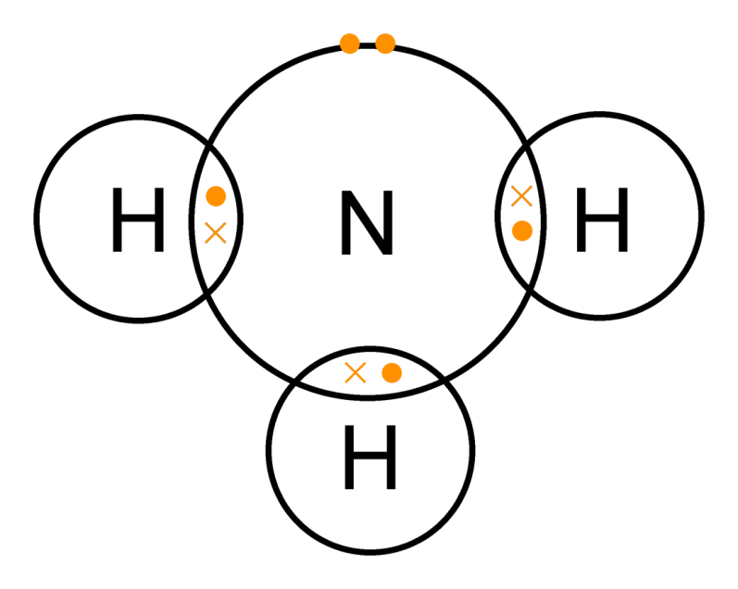
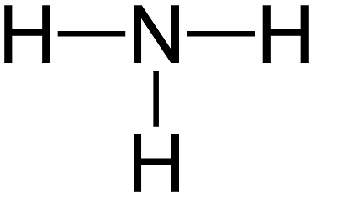
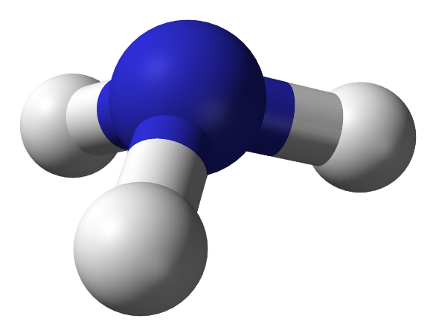
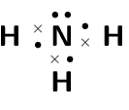
  Covalent bonding - PART 1
Covalently bonded substances may consist of small molecules. The covalent bond in molecules can be represented in the following models. Like all models, each one is useful but has some limitations.
Ammonia NH₃
Dot and cross with outer shells as circles:
+ Show which atom the
electrons in the bonds come
from
- All electrons are identical
2D with bonds:
+ Show which atoms are bonded together
3D ball and stick model:
+ Attempts to show the correct H-N-H bond angle is 107.8°
+ Shows the impact of the lone pair
- It shows the H-N-H bond
incorrectly at 90°
Dot and cross with outer shells electrons:
Notes:
https://www.google.co.uk/url?sa=i&rct=j&q=&esrc=s&source=images&cd=&cad=rja&uact=8&ved=0ahUKEwiPu_Gf4bjVAhWpqVQKHT5nDzwQjRwIBw&url=http%3A%2F%2Fwww.historyoftheuniverse.com%2Findex.php%3Fp%3Dnitrogen.htm&psig=AFQjCNHbB72WgjFaiV6T9gpkLrR0o42JUQ&ust=1501770468520684

Slide 21
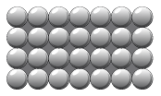
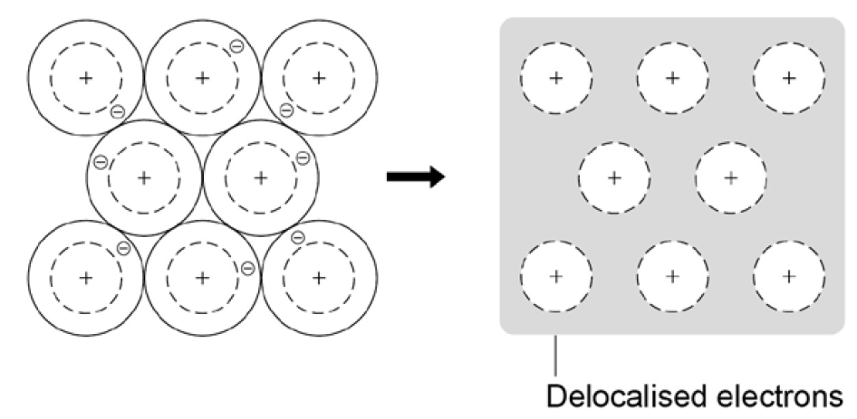
  Metallic bonding
The atoms in metals are built up layer upon layer in a regular pattern. They are another example of a giant structure.
The electrons in the outer shell of metal atoms are delocalised and are free to move throughout the structure.
The sharing of delocalised electrons leads to strong metallic bonds.
Metallic bonding can be represented in the following form:

Slide 22
QuestionIT!
Bonding
PART 2
  Covalent bonding
  Metallic bonding

Slide 23
  Bonding – Part 2 – QuestionIT
How are strong covalent bonds formed?
What are the three types of structure that can be formed by covalent bonding?
What are polymers an example of?
What type of structure do the following covalently bonded substances have?
  Water H₂O
  Silicon dioxide SO₂
  Diamond C
  Poly(ethene)

Slide 24
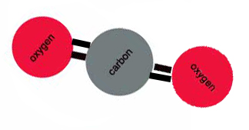
  Bonding – Part 2 – QuestionIT
What are the limitations of using dot and cross diagrams to represent covalent bonds?
How are atoms arranged in a metal?
Why are metallic bonds so strong?
What is the formula of the following model?

Slide 25
  Covalent bonding PART 1 – QuestionIT
Draw a dot and cross diagram for water.
Describe the arrangement of particles in a metal.
Why are the particles that make up a metal described as positively charged?
What are delocalised electrons?

Slide 26
AnswerIT!
Bonding
PART 2
  Covalent bonding
  Metallic bonding

Slide 27
  Bonding – Part 2 – QuestionIT
How are strong covalent bonds formed?
  Atoms share pairs of electrons.
What are the three types of structure that can be formed by covalent bonding?
  Small molecules, very large molecules, giant covalent molecules.
What are polymers an example of?
  Very large molecules.
What type of structure do the following covalently bonded substances have?
  Water H₂O Small covalent.
  Silicon dioxide SO₂ Giant covalent.
  Diamond C Giant covalent.
  Poly(ethene) Very large molecule.

Slide 28
  Bonding – Part 2 – QuestionIT
What are the limitations of using dot and cross diagrams to represent covalent bonds?
  It shows the electrons differently, when they are the same and it does not show the bond angles or shape of the molecule.
How are atoms arranged in a metal?
  Giant structures of atoms, arranged in a regular pattern, delocalised electrons.
Why are metallic bonds so strong?
  Sharing of delocalised electrons.
What is the formula of the following model?
  CO₂

Slide 29
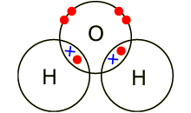
  Bonding – part 2 – QuestionIT
Draw a dot and cross diagram for water.
Describe the arrangement of particles in a metal.
  Atoms arranged neatly in rows; sea of delocalised electrons.
Why are the particles that make up a metal described as positively charged?
  The metal atoms lose outer shell electrons and therefore there
are more protons (+) than electrons (−).
What are delocalised electrons?
  They are free-moving electrons within structure; not associated
with a particular atom.

Slide 30
LearnIT!
KnowIT!
Properties of
substances Part 1
  States of matter
  State symbols

Slide 31
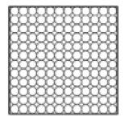
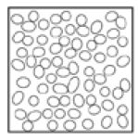
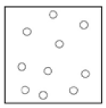
  States of matter and state symbols
There are three states of matter – solid, liquid and gas. To explain the properties of the states, the particle theory is used. It is based on the fact that all matter is made up of tiny particles and describes the movement and distance between particles.
Solid | Liquid | Gas
Close together, regular pattern, vibrate on the spot. | Close together, random arrangement, move around each other. | Far apart, random arrangement, move quickly.
In chemical equations, the three states are shown as (s), (l), (g)
and (aq) for aqueous solutions.

Slide 32
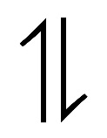
  Changes of state
Melting and freezing take place at the melting point.
Boiling and condensing take place at the boiling point.
The amount of energy required to change the state depends on the strength of the forces between the particles of the substance.
The stronger the forces between the particles the higher the melting and boiling point of the substance.
The type of bonding and the structure of the substance depend on the particles involved.
Freezing
Melting
Condensing
Boiling
HT ONLY - There are limitations of the particle model of matter:
There are no forces
All particles are shown as spheres
The spheres are solid

Slide 33
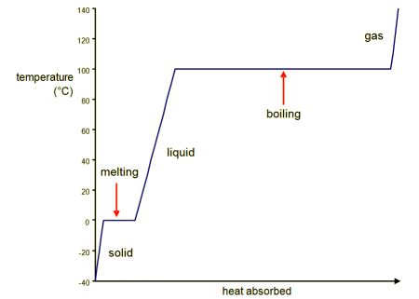
  Changes of state
The graph shows a heating curve of a solid, which shows the temperature of a substance plotted against the amount of energy it has absorbed:
A substance must absorb heat energy so that it can melt or boil. The temperature of the substance does not change during melting, boiling or freezing, even though energy is still being transferred.

Slide 34
QuestionIT!
Properties of
substances Part 1
  States of matter
  State symbols

Slide 35
  Properties of substances – Part 1 – QuestionIT
What are the three states of matter?
What is used to represent particles in the simple particle model?
What takes place at the melting point?
What takes place at the boiling point?
What factor affects the amount of energy needed to change state?

Slide 36
  Properties of substances – Part 1– QuestionIT
In chemical equations what symbols are used to show the states of matter?
In what state of matter do particles have the most energy?
What would eventually happen to a gas if pressure is increased?
HT ONLY: Explain the limitations of the particle model.

Slide 37
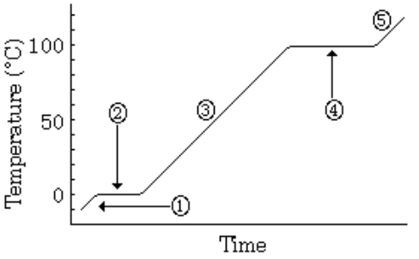
  Properties of substances – Part 1 QuestionIT
The following represents the heating of ice:
What change in state happens at stage 2?
b) What is happening at
stage 4?

Slide 38
AnswerIT!
Properties of
substances Part 1
  States of matter
  State symbols

Slide 39
  Properties of substances – Part 1– QuestionIT
What are the three states of matter?
  Solid, liquid, gas.
What is used to represent particles in the simple particle model?
  Small solid spheres.
What takes place at the melting point?
  Melting and freezing.
What takes place at the boiling point?
  Boiling and condensing.
What factor affects the amount of energy needed to change state?
  Forces between molecules.

Slide 40
  Properties of substances – Part 1– QuestionIT
In chemical equations what symbols are used to show the states of matter?
  Solid = (s); liquid = (l); gas = (g); aqueous = (aq)
In what state of matter do particles have the most energy?
  Gas.
What would eventually happen to a gas if pressure is increased?
  Condense into a liquid.
HT ONLY: Explain the limitations of the particle model.
  No forces, particles are shown as spheres, spheres are solid.

Slide 41
  Properties of substances – Part 1– QuestionIT
The following represents the heating of ice:
What change in state happens at stage 2?
Melting/ freezing
b) What is happening at
stage 4?
Boiling/ condensing

Slide 42
LearnIT!
KnowIT!
Properties of substances Part 2
  Ionic compounds
  Small molecules
  Polymers
  Giant covalent structures
  Metals and alloys

Slide 43
  Properties of ionic compounds
Structure
Ionic compounds have regular structures called giant ionic lattices.
There is strong electrostatic forces of attraction in all directions between oppositely changed ions.
Properties
High melting and boiling points – large amounts of energy is needed to break the many strong bonds and overcome the electrostatic attraction.
Conduct electricity when molten or dissolved in water – ions are free to move and can carry charge.

Slide 44
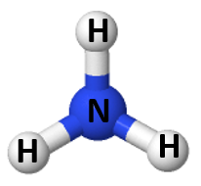
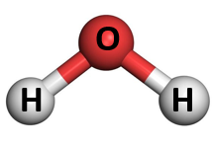
  Properties of small molecules
Structure
They have weak forces between the molecules. These weak forces are overcome when they change state not the strong covalent bonds.
Properties
Low melting and boiling points – small amounts of energy is needed to break the intermolecular forces. Most are gases or liquids.
Do not conduct electricity – Particles do not have an overall electric charge.
Intermolecular forces increase with the size of the molecules. So larger molecules have higher melting and boiling points.

Slide 45
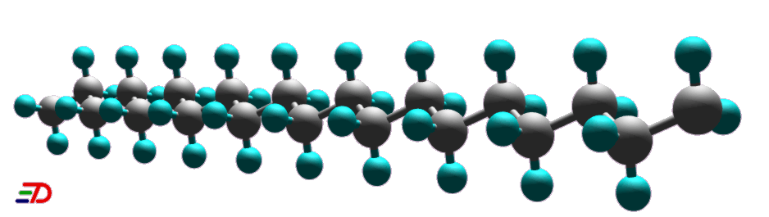
  Polymers
Some covalently bonded substances have very large molecules, such as polymers.
Structure
Polymers are made up from many small reactive molecules that bond to each other to form long chains. The atoms in the polymer molecules are linked to other atoms by strong covalent bonds. The intermolecular forces between polymer molecules are relatively strong.
Properties
Solid at room temperature – Strong intermolecular forces.

Slide 46
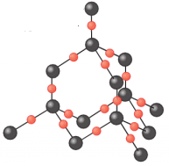
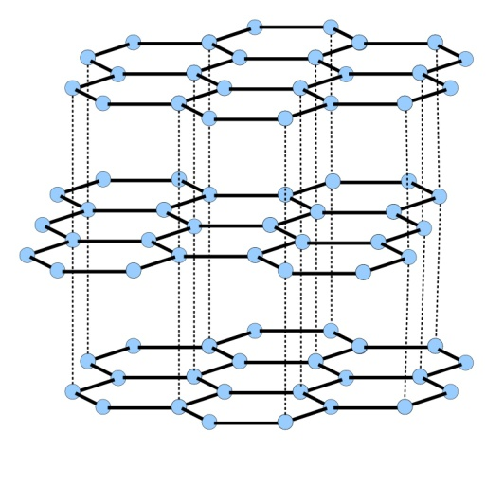
  Giant covalent structures
Structure
All atoms within the structure are linked by strong covalent bonds. These bonds must be broken for a solid to melt or boil.
Properties
Very high melting and boiling points – very large amounts of energy is needed to break the covalent bonds.
Do not conduct electricity – Particles do not have an overall electric charge.

Slide 47
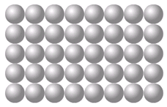
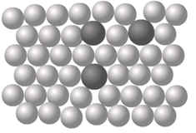
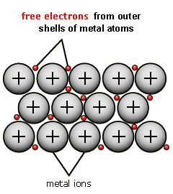
  Properties of metals and alloys
The giant structure of atoms with strong metallic bonding gives most metals a high melting and boiling point.
Metals are malleable (can be hammered into shape) and ductile (can be drawn out into a wire) because the layers of atoms (or ions) in a giant metallic structure can slide over each other
Delocalised electrons in metals enable electricity and heat to pass through the metal easily.
A metal mixed with other elements is called an alloy. Alloys are harder than pure metals. Alloys are made from two or more different metals.
Pure metal Alloy
The different sized atoms of the metals distort the layers in the structure, making it more difficult for them to slide over each other, and so make the alloys harder than pure metals.
For example, gold is naturally soft but adding copper to make jewellery stronger and last longer.

Slide 48
QuestionIT!
Properties of substances Part 2
  Ionic compounds
  Small molecules
  Polymers
  Giant covalent structures
  Metals and alloys

Slide 49
  Properties of substances – Part 2 – QuestionIT
Describe the structure of ionic compounds.
Why do ionic compounds have high melting and boiling points?
Why can ionic compounds conduct electricity when melted or dissolved in water?
What state of matter are small molecules normally found in?
Why do small molecules have low melting and boiling points?

Slide 50
  Properties of substances – Part 2 – QuestionIT
What happens to the melting and boiling points as small molecules get bigger? Why?
Why don’t small molecules conduct electricity?
What are polymers?
How are the atoms in a polymer linked together?
Why are polymers normally solid at room temperature?
Give an example of a giant covalent structure.

Slide 51
  Properties of substances – Part 2 – QuestionIT
Why do giant covalent structures have very high melting and boiling points?
Why do most metals have high melting and boiling points?
How are atoms arranged in pure metals?
What is an alloy?
Why do we use alloys, rather than pure metals, for many uses?

Slide 52
  Properties of substances – Part 2 – QuestionIT
Why are metals good conductors of electricity?
What is thermal energy?
Why are metals good conductors of thermal energy?

Slide 53
AnswerIT!
Properties of substances Part 2
  Ionic compounds
  Small molecules
  Polymers
  Giant covalent structures
  Metals and alloys

Slide 54
  Properties of substances – Part 2 – QuestionIT
Describe the structure of ionic compounds.
  Regular, giant ionic lattice.
Why do ionic compounds have high melting and boiling points?
  Strong electrostatic forces of attraction between ions.
Why can ionic compounds conduct electricity when melted or dissolved in water?
  Ions are free to move, carry the charge.
What state of matter are small molecules normally found in?
  Gas or liquid.
Why do small molecules have low melting and boiling points?
  Weak forces between molecules/ intermolecular forces.

Slide 55
  Properties of substances – Part 2 – QuestionIT
What happens to the melting and boiling points as small molecules get bigger? Why?
  Increases, intermolecular forces get bigger.
Why don’t small molecules conduct electricity?
  Do not have an overall electric charge.
What are polymers?
  Very large molecules made of repeating units.
How are the atoms in a polymer linked together?
  Strong covalent bonds.
Why are polymers normally solid at room temperature?
  Intermolecular forces relatively strong.
Give an example of a giant covalent structure.
  Diamond, graphite, silicon dioxide.

Slide 56
  Properties of substances – Part 2 – QuestionIT
Why do giant covalent structures have very high melting and boiling points?
  Strong covalent bonds must be broken.
Why do most metals have high melting and boiling points?
  Strong metallic bonding.
How are atoms arranged in pure metals?
  Layers.
What is an alloy?
  Mixture of two elements, one of which is a metal.
Why do we use alloys, rather than pure metals, for many uses?
  They are harder as the layers are distorted.

Slide 57
  Properties of substances – Part 2 – QuestionIT
Why are metals good conductors of electricity?
  Electrical charge carried by delocalised electrons.
What is thermal energy?
  Heat energy.
Why are metals good conductors of thermal energy?
  Energy is transferred by delocalised electrons.

Slide 58
LearnIT!
KnowIT!
Properties of substances Part 3
  Diamond
  Graphite
  Graphene and fullerenes

Slide 59
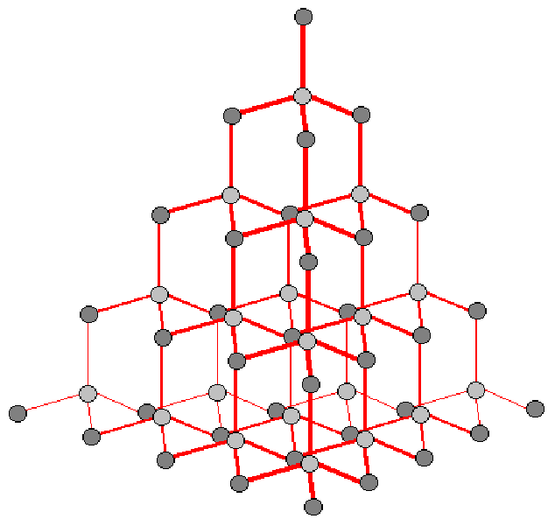
  Diamond
Diamond:
In diamond, each carbon atom forms four covalent bonds with other carbon atoms in a giant covalent structure.
Diamond is very hard – it is the hardest natural substance, so it is often used to make jewellery and cutting tools.
Diamond has a very high melting and boiling point – a lot of energy is needed to break the covalent bonds.
Diamond cannot conduct electricity – there are no free electrons or ions to carry a charge.
Notes:
https://www.google.co.uk/url?sa=i&rct=j&q=&esrc=s&source=images&cd=&cad=rja&uact=8&ved=0ahUKEwjb_7i7gbnVAhUBohQKHTa6AYMQjRwIBw&url=http%3A%2F%2Fweknownyourdreamz.com%2Fsymbols%2Fsymbol-for-silicon-dioxide.html&psig=AFQjCNF6pkoi_opTPCYLPtR-tFf3ucWV1g&ust=1501779137465594

Slide 60
  Graphite
Graphite:
In graphite, carbon atom forms three covalent bonds with three other carbon atoms, forming layers of hexagonal rings which have no covalent bonds between the layers.
Graphite is soft and slippery – layers can easily slide over each other because the weak forces of attraction between the layers are easily broken. This is why graphite is used as a lubricant.
Graphite conducts electricity – the only non-metal to do so. One electron from each carbon atom is delocalised.

Slide 61
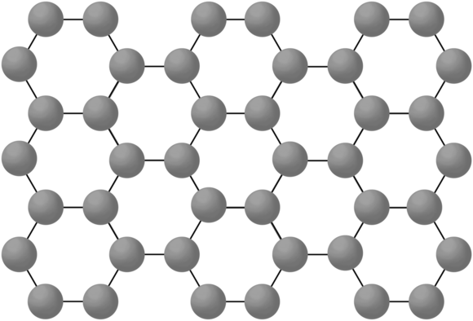
  Graphene
Graphene:
This is a single layer of graphite – a layer of inter-locking hexagonal rings of carbon atoms one atom thick.
It is an excellent conductor of thermal energy and electricity (even better than graphite), has a very low density and is incredibly strong.
It has many uses in the electronics industry.
Notes:
https://images.techhive.com/images/article/2014/04/graphene_structure-100263091-orig.png

Slide 62
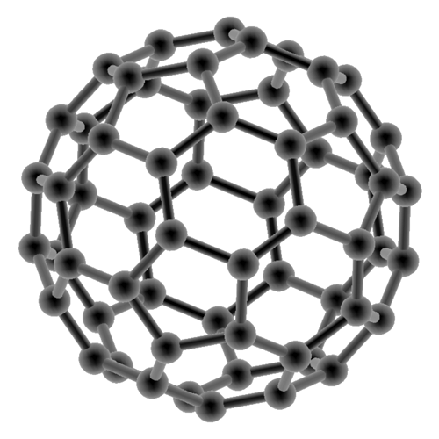
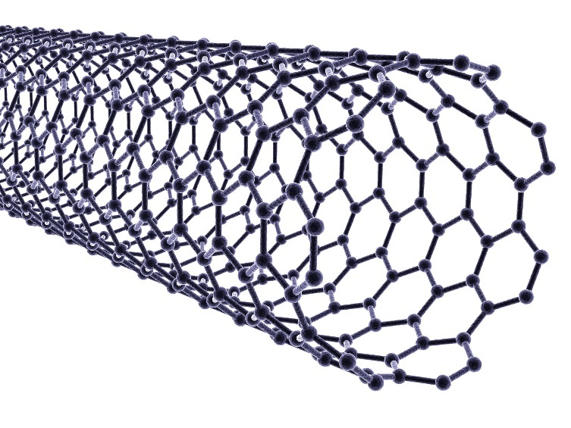
  Fullerenes
Fullerenes:
Fullerenes are molecules of carbon with hollow shapes.
The structure is based on hexagonal rings of carbon
atoms, but may have 5 or 7 carbon rings. The first to be
discovered was Buckminsterfullerene (C₆₀)
which is spherical (like a football).
Carbon nanotubes are cylindrical fullerenes with very high length compared to their diameter. This makes them useful for nanotechnology, electronics and materials.

Slide 63
QuestionIT!
Properties of substances Part 3
  Diamond
  Graphite
  Graphene and fullerenes

Slide 64
  Properties of substances – Part 3 – QuestionIT
In a diamond, how many covalent bonds does each carbon make?
Diamond does not conduct electricity. Why?
Name 2 other properties of diamond.
In graphite, how many covalent bonds does each carbon make?
Describe the structure of graphite.
Why is graphite soft?

Slide 65
  Properties of substances – Part 3 – QuestionIT
Why does graphite conduct electricity?
How is graphite similar to metals?
What is graphene?
What are fullerenes?
What was the first fullerene to be discovered?
What are carbon nanotubes?
What are carbon nanotubes useful for?

Slide 66
AnswerIT!
Properties of substances Part 3
  Diamond
  Graphite
  Graphene and fullerenes

Slide 67
  Properties of substances – Part 3 – QuestionIT
In a diamond, how many covalent bonds does each carbon make?
  4
Diamond does not conduct electricity. Why?
  No delocalised electrons.
Name 2 other properties of diamond.
  Hard, very high melting point.
In graphite, how many covalent bonds does each carbon make?
  3
Describe the structure of graphite.
  Layers of hexagonal rings.
Why is graphite soft?
  Layers can slide over each other, weak forces between layers, no covalent bonds between layers.

Slide 68
  Properties of substances – Part 3 – QuestionIT
Why does graphite conduct electricity?
  Each carbon has one delocalised electron.
How is graphite similar to metals?
  It contains delocalised electrons.
What is graphene?
  Single layer of graphite, 1 atom thick.
What are fullerenes?
  Molecules of carbon atoms with hollow shapes.
What was the first fullerene to be discovered?
  Buckminsterfullerene.
What are carbon nanotubes?
  Cylindrical fullerenes.
What are carbon nanotubes useful for?
  Electronics, nanotechnology and materials.

Slide 69
LearnIT!
KnowIT!
Nanoparticles (Chemistry ONLY)
  Sizes of particles and their properties
  Uses of nanoparticles

Slide 70
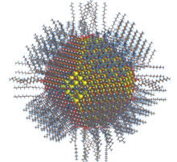
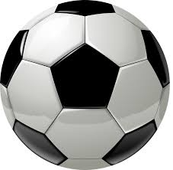

  Covalent bonding - PART 3
  CHEMISTRY ONLY
Nanoscience is the study of small particles that are between 1 and 100 nanometres in size. Particles consisting of fewer than 100 atoms are often called nanoclusters.
1 nanometre (1 nm) = 1 x 10⁻⁹ metres
(0.000 000 001m or a billionth of a metre).
Nanoparticles are smaller than fine particles (PM_{2.5}) which have diameters between
1 x 10⁻⁷ metres and 2.5 x 10⁻⁶ .
To comprehend how small this is, coarse particles, like dust, have diameters between 1 x 10⁻⁵ and 2.5 x 10⁻⁶ .
The size of a typical nanoparticle is …
… to a football as a
football is …
…to the Earth

Slide 71
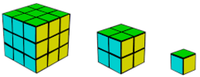
  Covalent bonding - PART 3
  CHEMISTRY ONLY
Nanoparticles show different properties to the same materials in bulk as they have a high surface area to volume ratio.
The diagram shows this idea:
As particle size gets smaller, the surface area to volume ratio gets larger.
As the side of cube decreases by a factor of 10 the surface area to volume ratio increases by a factor of 10.
Nanoparticles show different properties to the same materials in bulk and have a high surface area to volume ratio. It also means that smaller quantities are needed to be effective than the materials with normal particle sizes.
Surface area (height x width x number of sides) | 3x3x6 =54 | 2x2x6 =24 | 1x1x6 =6
Volume (height x width x length) | 3x3x3 =27 | 2x2x2 =8 | 1x1x1 =1
Surface to volume ratio (surface area / volume) | 54/27 =2 | 24/8 =3 | 6/1 =6

Slide 72
  Covalent bonding - PART 3
  CHEMISTRY ONLY
Nanoparticles have many applications in medicine, in electronics, in cosmetics and sun creams, as deodorants, and as catalysts.
New developments in nanoscience are very exciting but will need more research into possible issues that might arise from their increased use.
There are some concerns that nanoparticles may be toxic to people. They may be able to enter the brain from the bloodstream and cause harm. Some people think more tests should take place before nanoparticles of a material are used on a wider scale.
Health care
Cosmetics
Clothing
Electronics
Catalysts
Uses of nanoparticles
Food
Paints
Biomedical
Sports equipment
Industrial
Learn three examples for your exam

Slide 73
QuestionIT!
Nanoparticles (Chemistry ONLY)
  Sizes of particles and their properties
  Uses of nanoparticles

Slide 74
  Nanoparticles CHEMISTRY ONLY – QuestionIT
What does nanoscience refer to?
What are nanoparticles?
What are coarse particles?
Why do nanoparticles have different properties from those for the same materials in bulk?
Name 5 uses of nanoparticles.

Slide 75
AnswerIT!
Nanoparticles (Chemistry ONLY)
  Sizes of particles and their properties
  Uses of nanoparticles

Slide 76
  Nanoparticles CHEMISTRY ONLY – QuestionIT
What does nanoscience refer to?
  Structures that are 1-100nm in size, a few hundred atoms.
What are nanoparticles?
  Smaller than fine particles.
What are coarse particles?
  Diameters between 1 x 10⁻⁵m and 2.5 x10⁻⁶m
Why do nanoparticles have different properties from those for the same materials in bulk?
  They have a high surface area to volume ratio. Smaller quantities are needed to be effective.
Name 5 uses of nanoparticles.
  Medicine, electronics, cosmetics, sunscreens, deodorants, catalysts.

